Slide 1
Bringing the Gag Rule Home to the U.S.
Jacqueline Ayers

Slide 2
Conflict of Interest Disclosure
The speaker does not have any conflicts of interest to disclose.

Slide 3
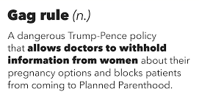
What is the Title X “Gag” Rule?

Slide 4
Title X Gag Rule
Makes it impossible for patients to get preventive care at Planned Parenthood
Providers are prevented from referring patients for abortion
Removes guarantee that patients receive full and accurate information from their providers
Removes requirement that contraception be medically approved, and that providers ensure access to full range of birth control

Slide 5
Title X Overview
Title X provides contraception, well-woman exams, counseling, STI testing & treatment, & cancer screenings
4 million
people served annually
65%
of patients have incomes under 100% Federal Poverty Level
Over 4 million STI & HIV tests provided

Slide 6
Planned Parenthood Played Outsized Role in Title X
PP served
41% of Title X
patients
& 13% of
Title X centers
Many PP health
centers
participated
in Title X

Slide 7
We’re Fighting Back
Public education & movement building
Lifting patient, provider & partner voices
Broadening our coalitions
Connecting the dots across Trump-Pence policies
Engaging Congressional champions

Slide 8
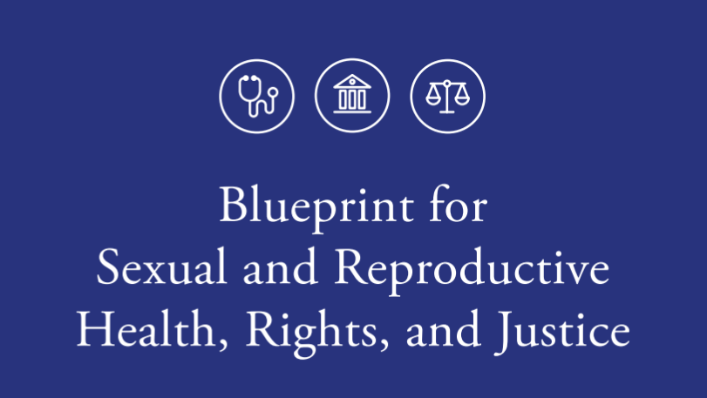
A proactive agenda by over 90 organizations to advance sexual and reproductive health
ReproBlueprint.org

